Slide 1
IPFS Analytics Competition
Eric VanMeerhaeghe | M.S. Data Analytics

Slide 2
Presentation Outline
Project Overview and Goals
Data Definitions:
Explanation of variables
Dealing with Class Imbalance
Results and Key Findings:
EDA: Who is the IPFS Customer?
Logit Model Results and Rationale
Top 7 Key Predictors of Cancellation
Predictive Models Used
Summary of Findings and Recommendations
Notes:
May require more than one slide

Slide 3
Project Overview – Background
IPFS is a Kansas City based Premium Finance Loan Lender
Received 3 Years of Loan Cancellation Data from IPFS
Goal of analysis was two-fold:
1: Determine which factors were significantly associated with Loan Cancellation
2: Build a model to accurately predict future loan cancellations

Slide 4
Project Overview – Focus of Analysis
Focus of Analysis:
What are the factors that explain loan cancellation?
Are there policy implications/changes in business rules that are necessary based on these findings?
What actions can IPFS take to mitigate future loan cancellation given the findings of this analysis?
Which model performed best in terms of Recall Score?
Value-add(s) for IPFS:
Minimizing cancellations accomplishes:
Agents have more stability in their book of business (Good for employees)
Difference in earned premium can be re-invested in business/distributed among shareholders (Good for investors)
More careful underwriting -> preventing company loss of income (Good for the company; Reduce insolvency risk)
Notes:
May require more than one slide

Slide 5
Data Definitions
1. Explanation of Variables
2. Dealing with Class Imbalance

Slide 6
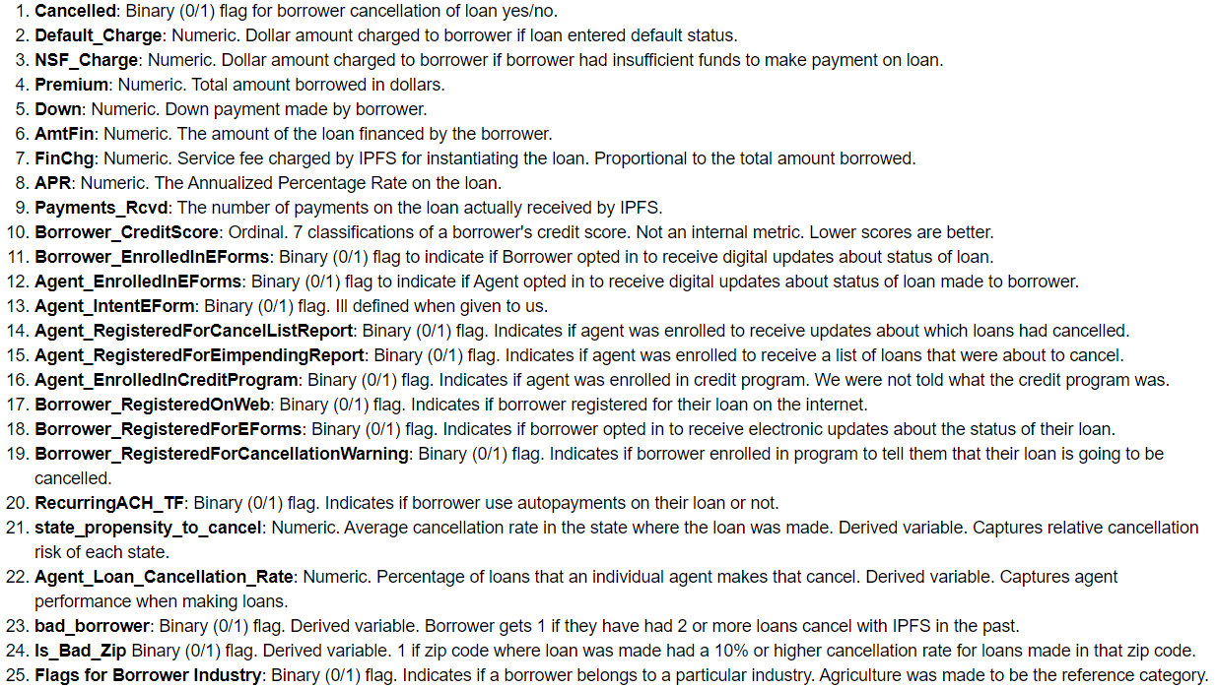
Explanation of Variables

Slide 7
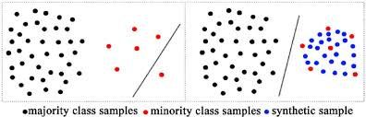
Dealing with Class Imbalance
Used a technique called SMOTE
Stands for Synthetic Minority Oversampling TEchnique
Creates synthetic data points of the minority class that have similar characteristics

Slide 8
Results and Key Findings

Slide 9
Results and Key Findings
Cancellations over time
Who is the typical IPFS customer?
What factors were associated with cancellation?
Logit model results and rationale
7 Most important predictors of cancellation with visualizations
Explanation of other predictive models used.
Notes:
May require more than one slide

Slide 10
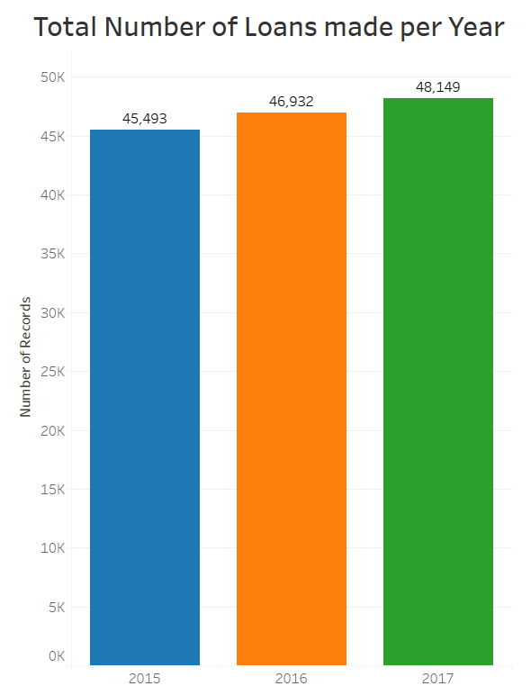
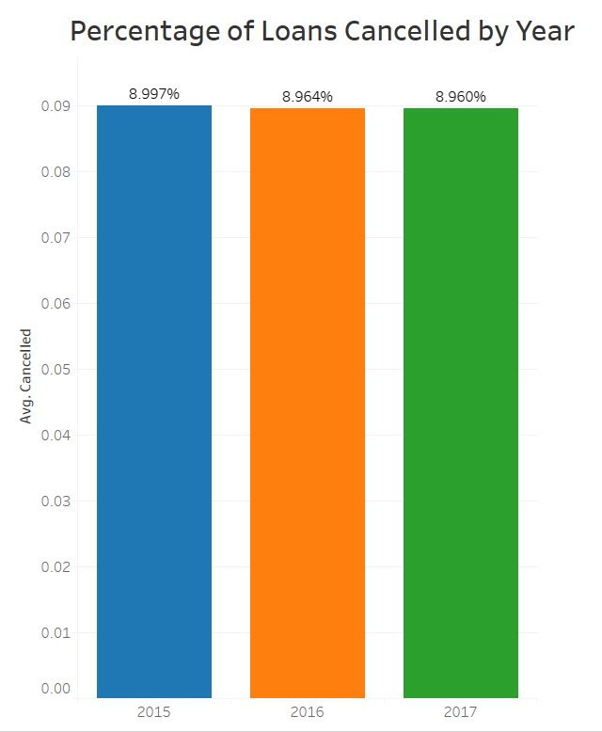
Cancellations Over Time
The total number of loans made to borrowers increased each year in this data.
Loan Cancellation rate hovers around 8.9%, while total loans made increase year over year.

Slide 11
Who is the IPFS Customer
Average Premium: $23,379.54
Average Down Payment: $4,592.27
Average Amount Financed: $18,782.27
Average Borrower Credit Score: 2.69
Percent of Borrowers enrolled in Eforms: 30.29%
Percent of Borrowers Registered on Web: 26.07%
Percent of Borrowers with Good or Great Credit: 30.69%
Percentage of Borrowers using Autopay: 0.89%

Slide 12
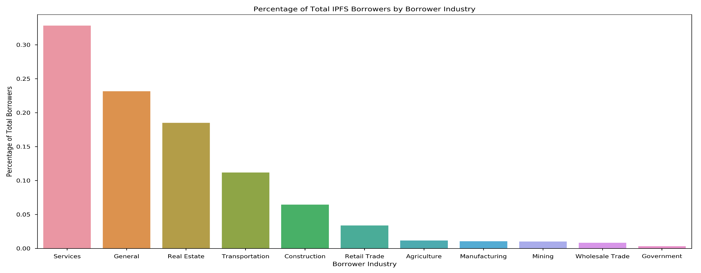
Who is the IPFS Customer
Over 85 % of IPFS Customers come from just 4 industries:

Slide 13
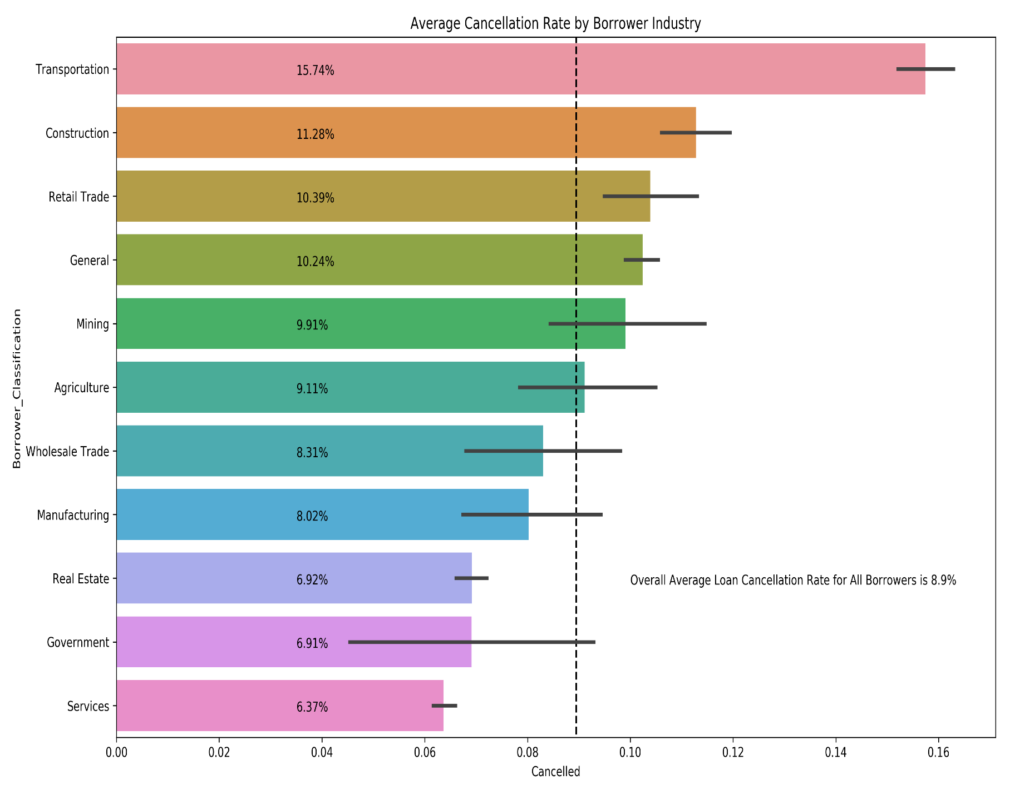
Who is the IPFS Customer
Real Estate and Service make up over 50% of IPFS Customers and they have significantly below average cancellation rates.

Slide 14
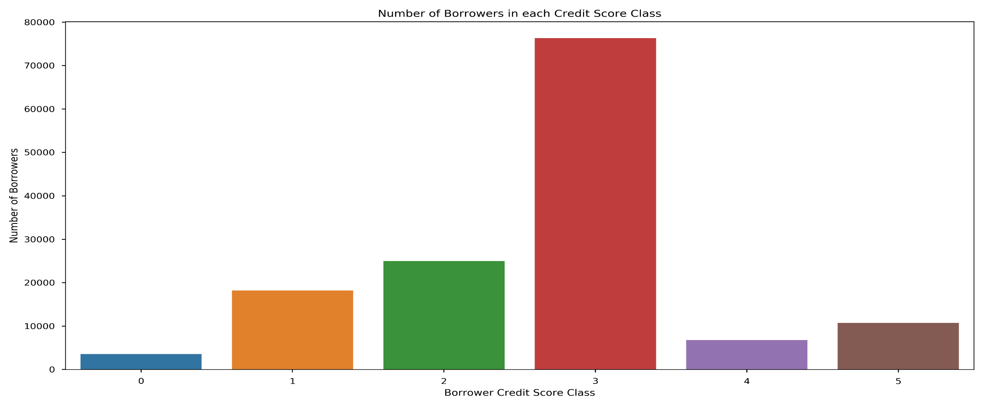
Who is the IPFS Customer
Most customers fall in Credit Score Class 3

Slide 15
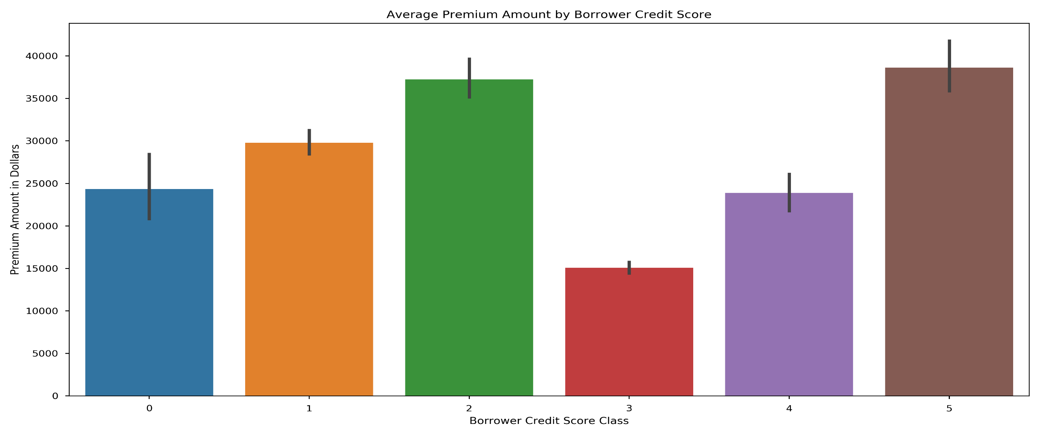
Who is the IPFS Customer
More credit worthy borrowers tend to borrow larger amounts, except class 5 borrowers.

Slide 16
Logit Model Results and Rationale

Slide 17
Why Use A Logit Model?
Simplicity
Computational Efficiency
Interpretability of Results

Slide 18
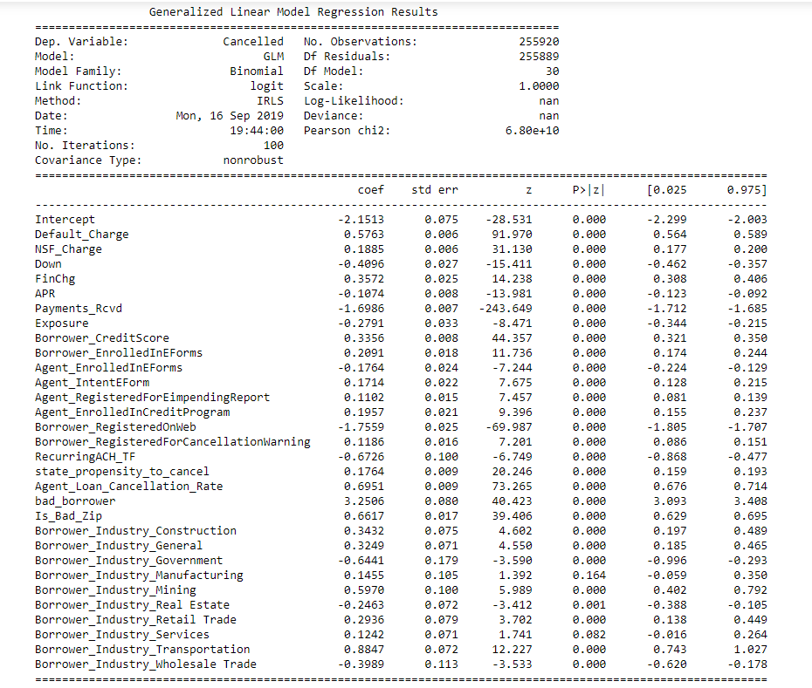
Full List of Factors Used in Logit Model

Slide 19
7 Most Important Predictors of Cancellation
Number of Payments Received
Default Charge Amount
Agent Loan Cancellation Rate
Borrower Registered on Web
Borrower Credit Score
Bad Borrower Flag
Problematic/Risky Zip Code

Slide 20
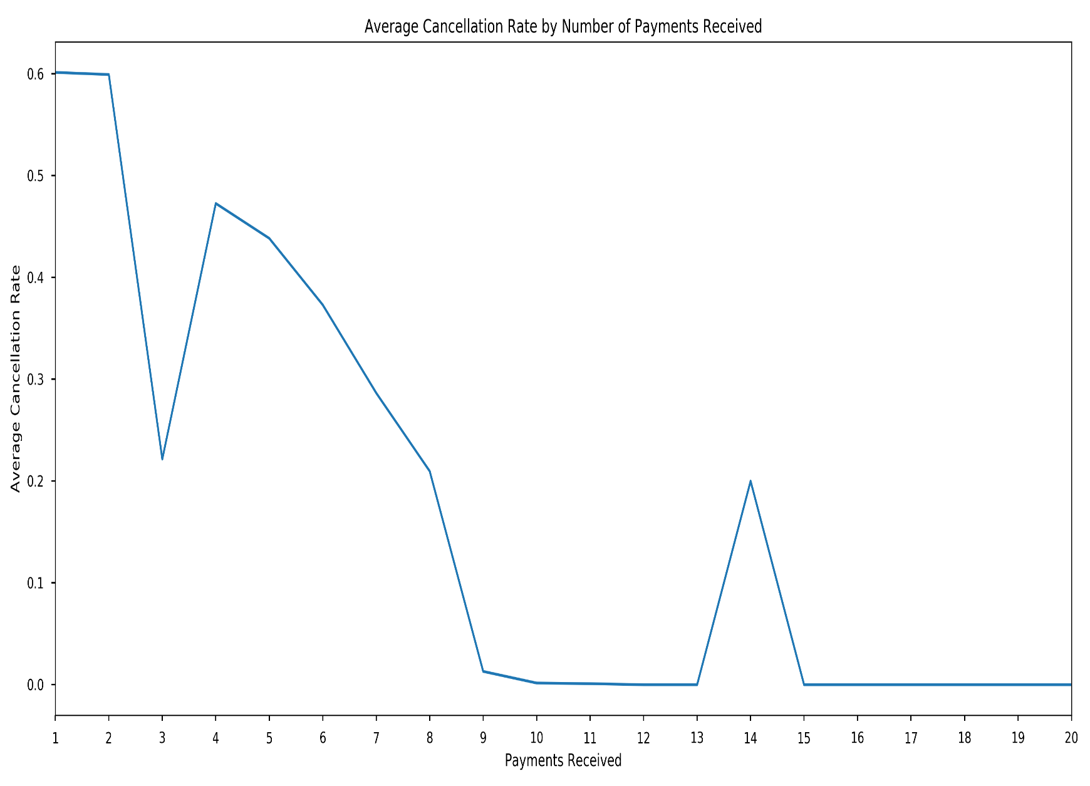
Number of Payments Received and Cancellation Rate
There is a clear trend of decreasing cancellation rates as more payments are received.

Slide 21
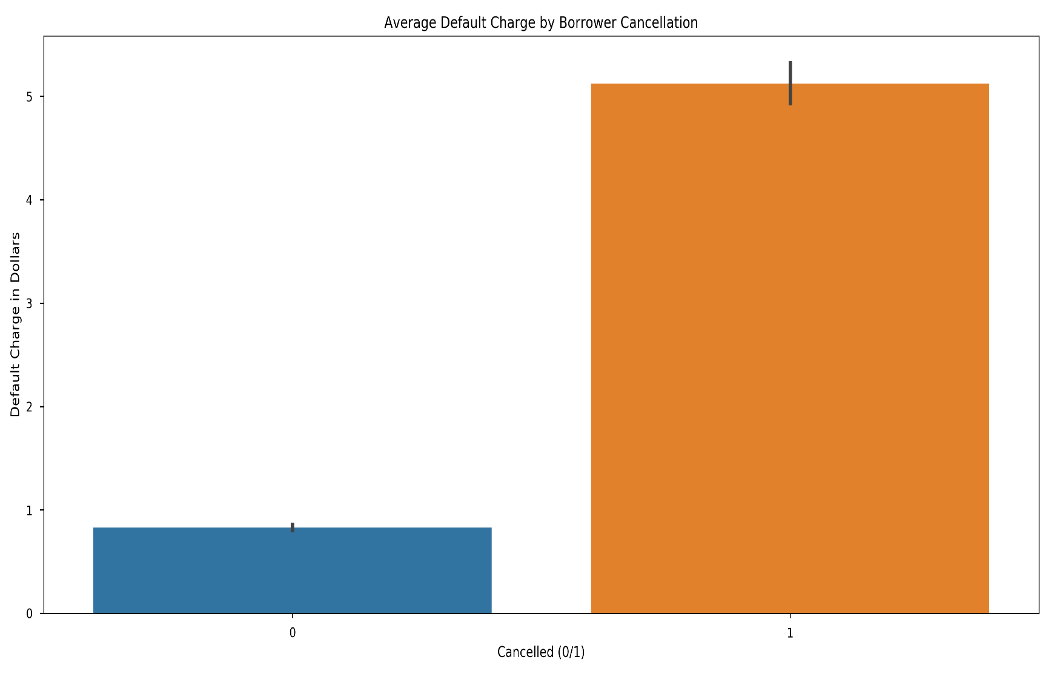
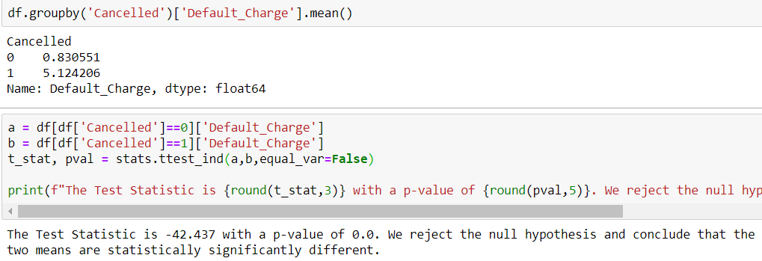
Default Charge and Cancellation
Those borrowers who had their loans cancel incurred significantly higher default charges from IPFS

Slide 22
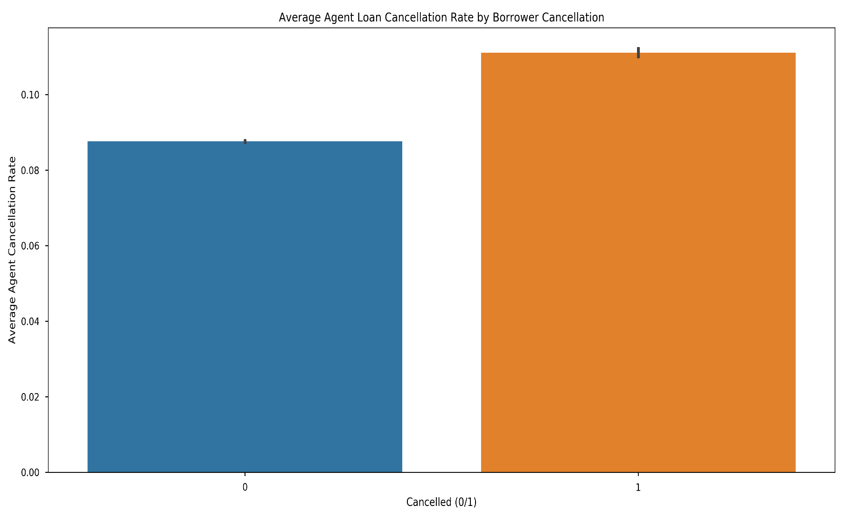
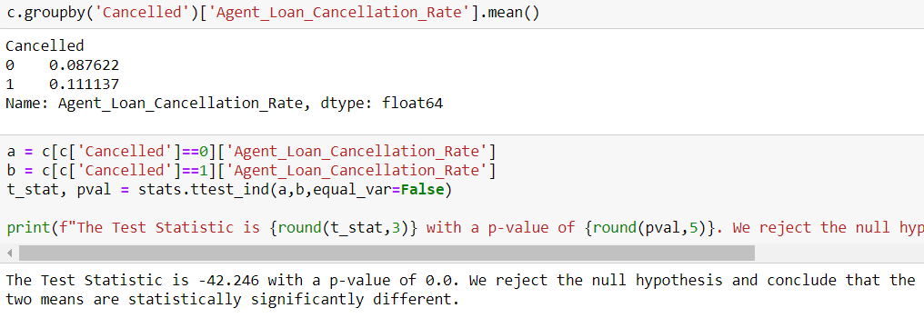
Agent Performance and Cancellation Rates
Derived variable. Percentage of total loans made by an agent that cancelled.
People’s loans that cancelled had agents with higher cancellation rates on average.
Cancellation might be partially due to poor agent performance.

Slide 23
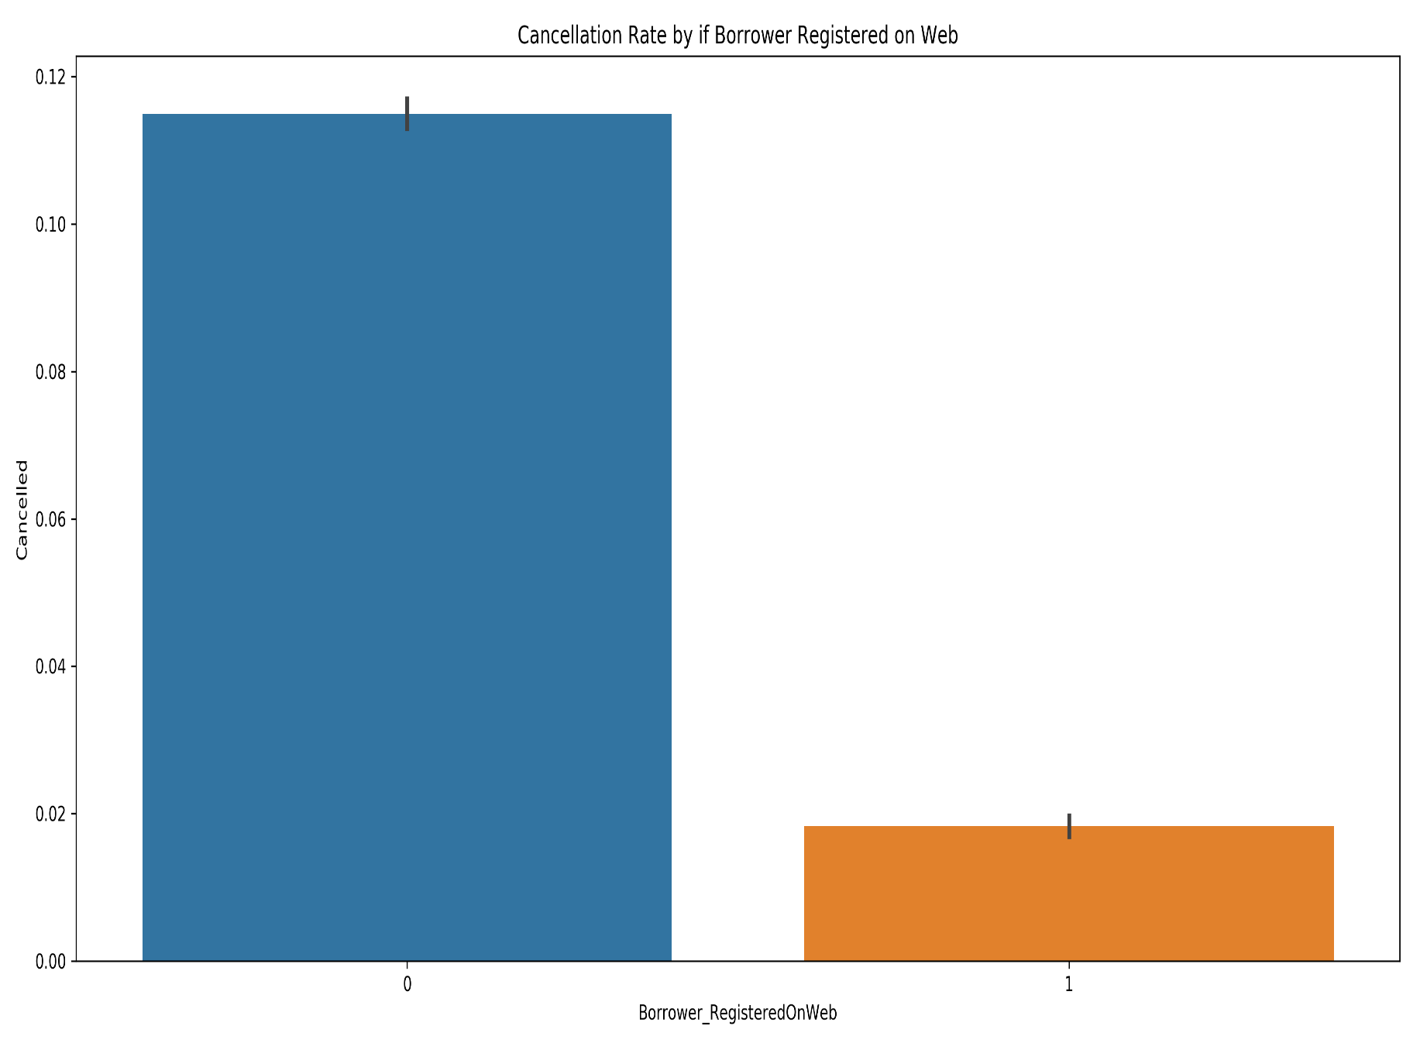
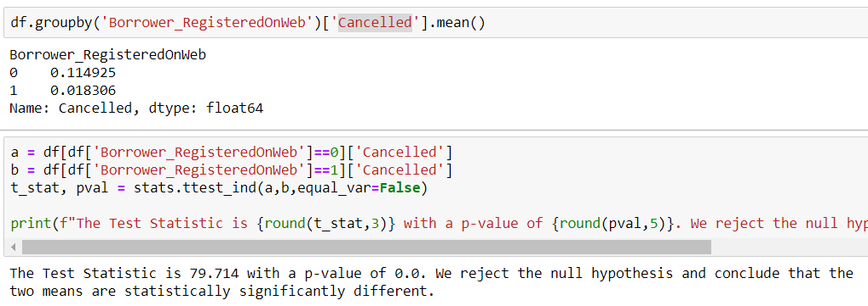
Borrower Web Registration and Loan Cancellation
Borrowers who did not register for their loan on the web cancelled at roughly 6.25 times the rate that those who did register on the web cancelled.

Slide 24
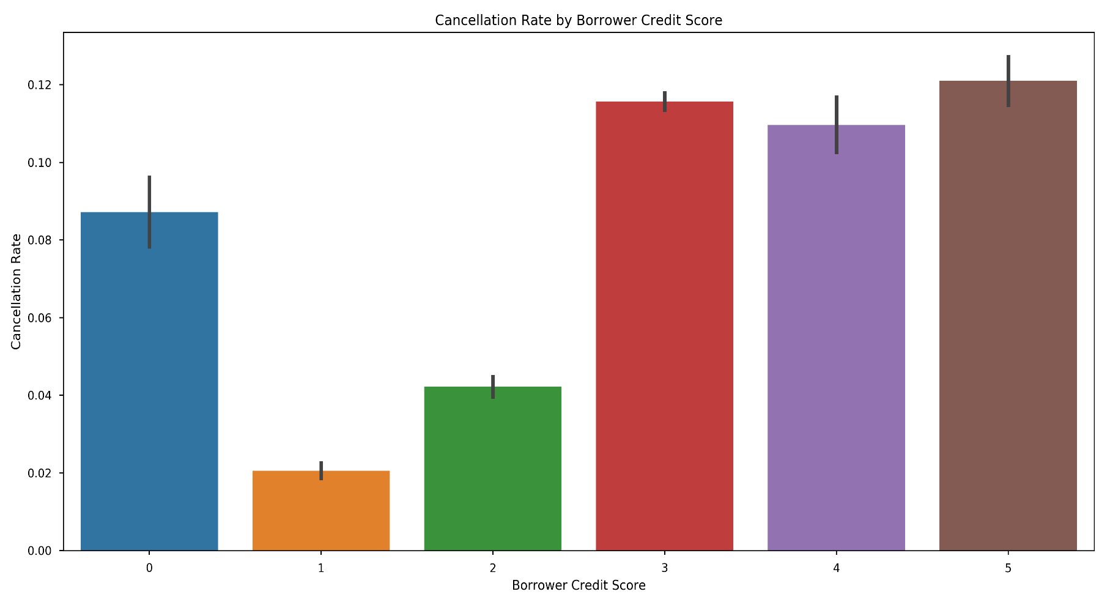
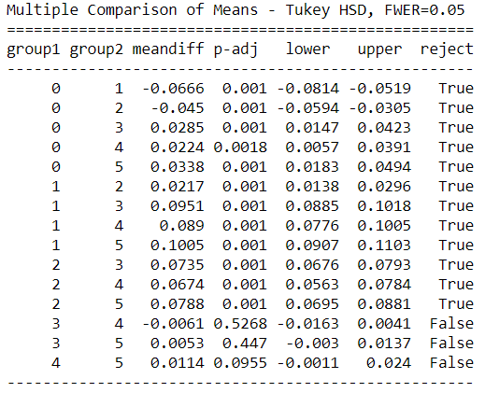
Borrower Credit Score and Cancellation Rates
There are clear differences between good and bad credit borrowers in terms of loan cancellation rates.
More credit worthy people cancel much less frequently.
Classes 3,4, and 5 cancel at statistically the same rate according to the Tukey HSD Multiple Comparison of Means Test.

Slide 25
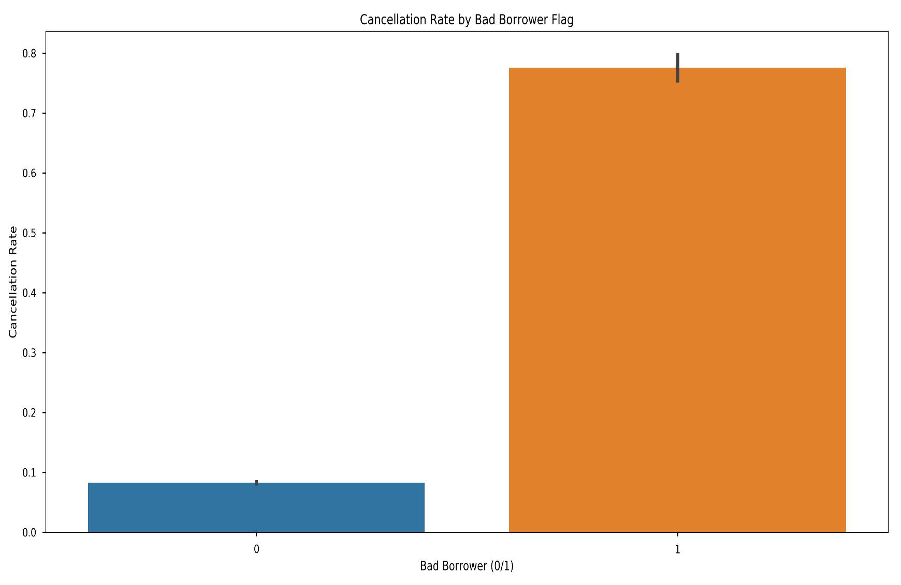
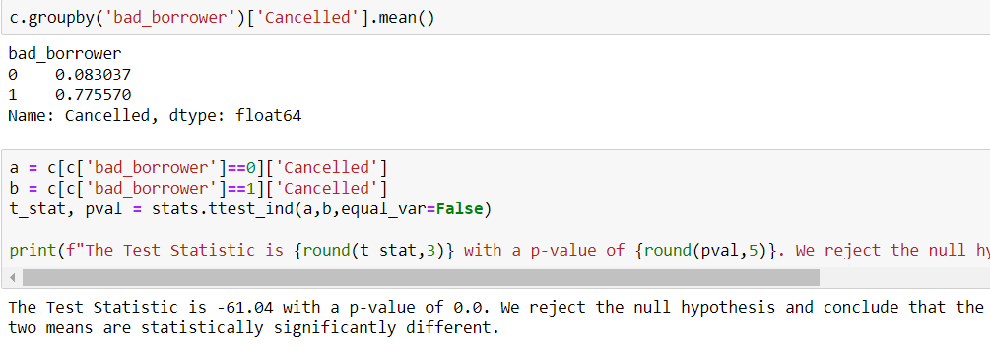
Bad Borrower Flag and Cancellation Rates
There is a clear association with cancellation if a borrower has cancelled at least one loan with IPFS in the past.
The estimated odds of cancelling a loan are 28.52 times higher for borrowers who have cancelled at least 1 loan with IPFS than for borrowers who have not cancelled a loan.

Slide 26
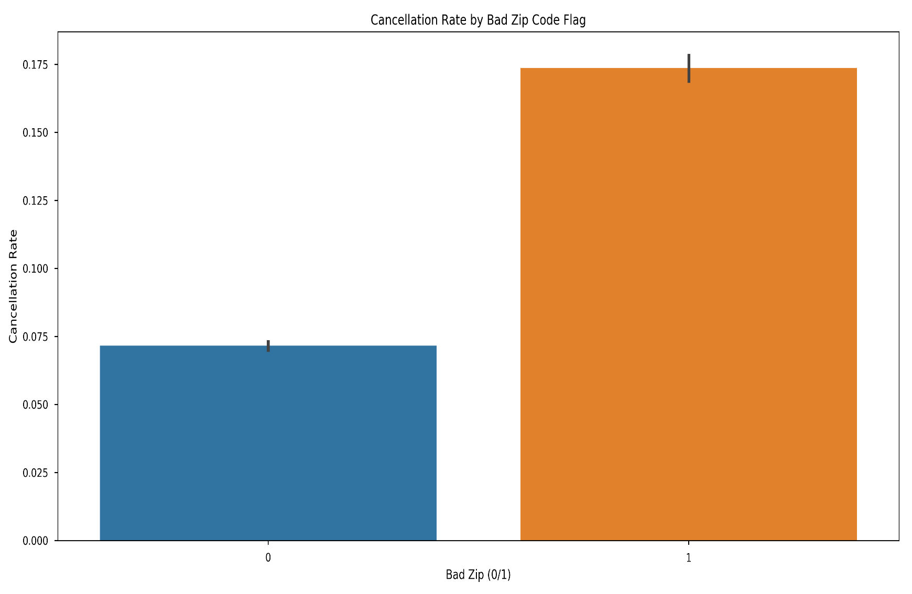
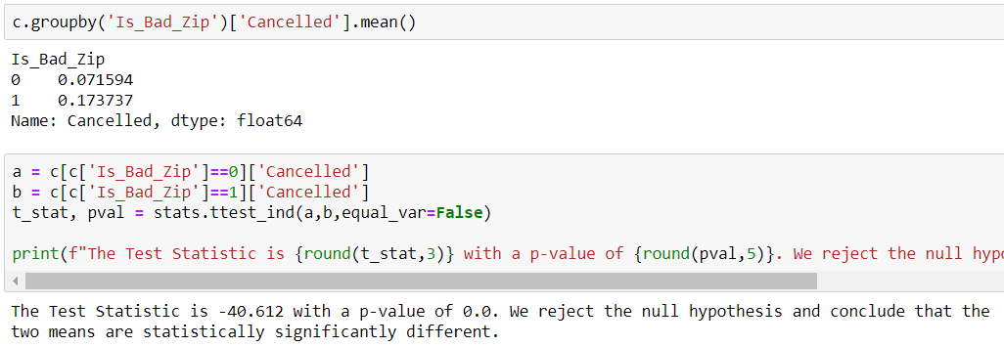
Risky Zip Codes and Loan Cancellation Rates
Borrowers from zip codes known to have a significantly higher than average cancellation rate tend to cancel their loans more often than people from non problematic zip codes.
The estimated odds of loan cancellation are 1.94 times higher for people in bad zip codes vs people not in bad zip codes.

Slide 27
Other Predictive Models Used

Slide 28
Predictive Models Used
KNN Classifier
Decision Tree Classifier
Random Forest Classifier
XGBoost (Gradient Boosted Tree Classifier)
Multi-Layer Perceptron Classifier

Slide 29
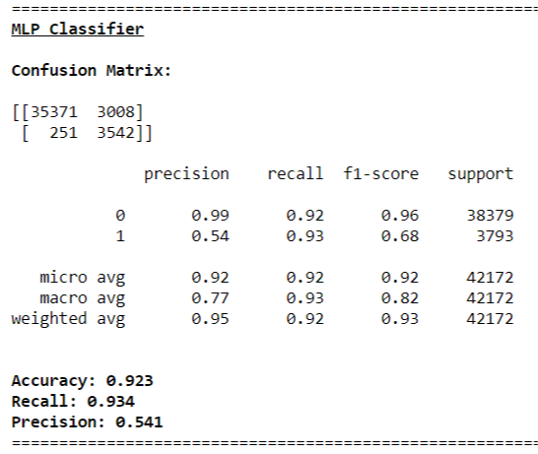
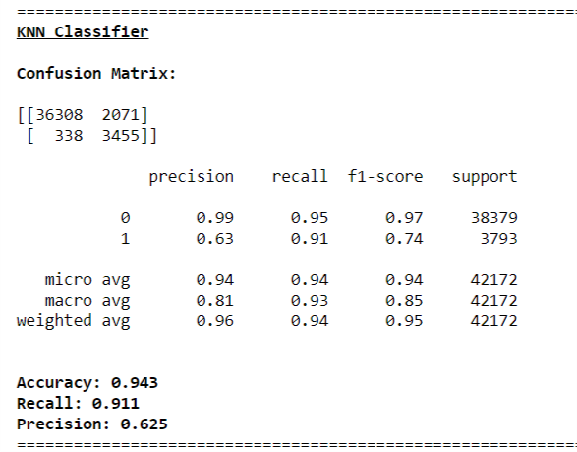
Top 2 Best Performing Models
Selected MLP Classifier because of higher recall score

Slide 30
Summary of Findings and Recommendations

Slide 31
Summary of Findings
A potential profile of a safe borrower is as follows:
Borrower Registers on the web and uses the internet to service their loan/get updates about their loan (EForms)
Borrower does not incur Default Charges
Borrower has no history of loan cancellation with IPFS
Borrower does not work in transportation or construction
Borrower has good to great credit
Borrower is not from a high-risk zip code
A potential profile of a risky borrower is as follows:
Borrower does not use internet to service loan/does not use EForms
Borrower incurs Default or Late Charges
Borrower has average to poor credit and is asking for a large loan
Borrower works in transportation or construction
Borrower is from a high-risk zip code

Slide 32
Recommendations
Encourage or Require Borrowers to register on the web and use E-Forms.
Never lend to borrowers who have cancelled a loan with IPFS.
More thorough and detailed vetting of borrowers wanting larger loans if their credit is not good or great.
Monitor individual agent performance to see if agent actions or lack thereof contribute to higher cancellation rates.
More strict requirements for borrowers who work in Transportation or Construction.

Slide 33
Quick Recap
Loan Cancellation Rate has remained static over time despite increased loan volume.
7 Most Important Variables are:
Number of Payments Received
Default Charge Amount
Agent Loan Cancellation Rate
Borrower Registration on Web
Borrower Credit Score
Bad Borrower Flag
High-risk zip code
We recommend that IPFS enact the following if possible:
Encourage or Require Borrowers to register on the web, use E-Forms.
Never lend to borrowers who have cancelled a loan with IPFS.
More thorough and detailed vetting of borrowers who meet some or all of the criteria described previously that characterize a risky borrower.
Monitor Agent Performance
More stringent loan terms for borrowers in Transportation or Construction.

Slide 34
Questions?

